Slide 1
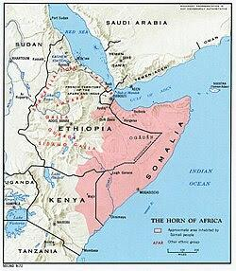
.Somalia.
By me and isaic

Slide 2
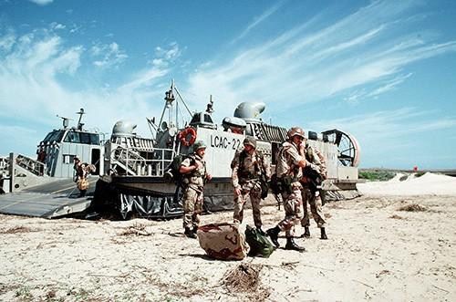
Global issue
Extreme Hunger Over 6.5 million people do not have enough food to eat lots of people have died 2 million young children that's only children what about grown up Skipping Meals for Children In starving families, parents especially mothers often completely stop eating for days so their children can have whatever food is left The Drought to Flood Cycle Countries are hitting a brutal loop where months of severe drought harden the soil. When torrential rains finally arrive, the ground cannot absorb the water, creating massive flash floods that wash away entire fields of crops and Global Crop Failures Major global food exporters including regions in Asia, the Americas, and Africa are experiencing simultaneous harvest losses in staples like rice, wheat, and corn

Slide 3
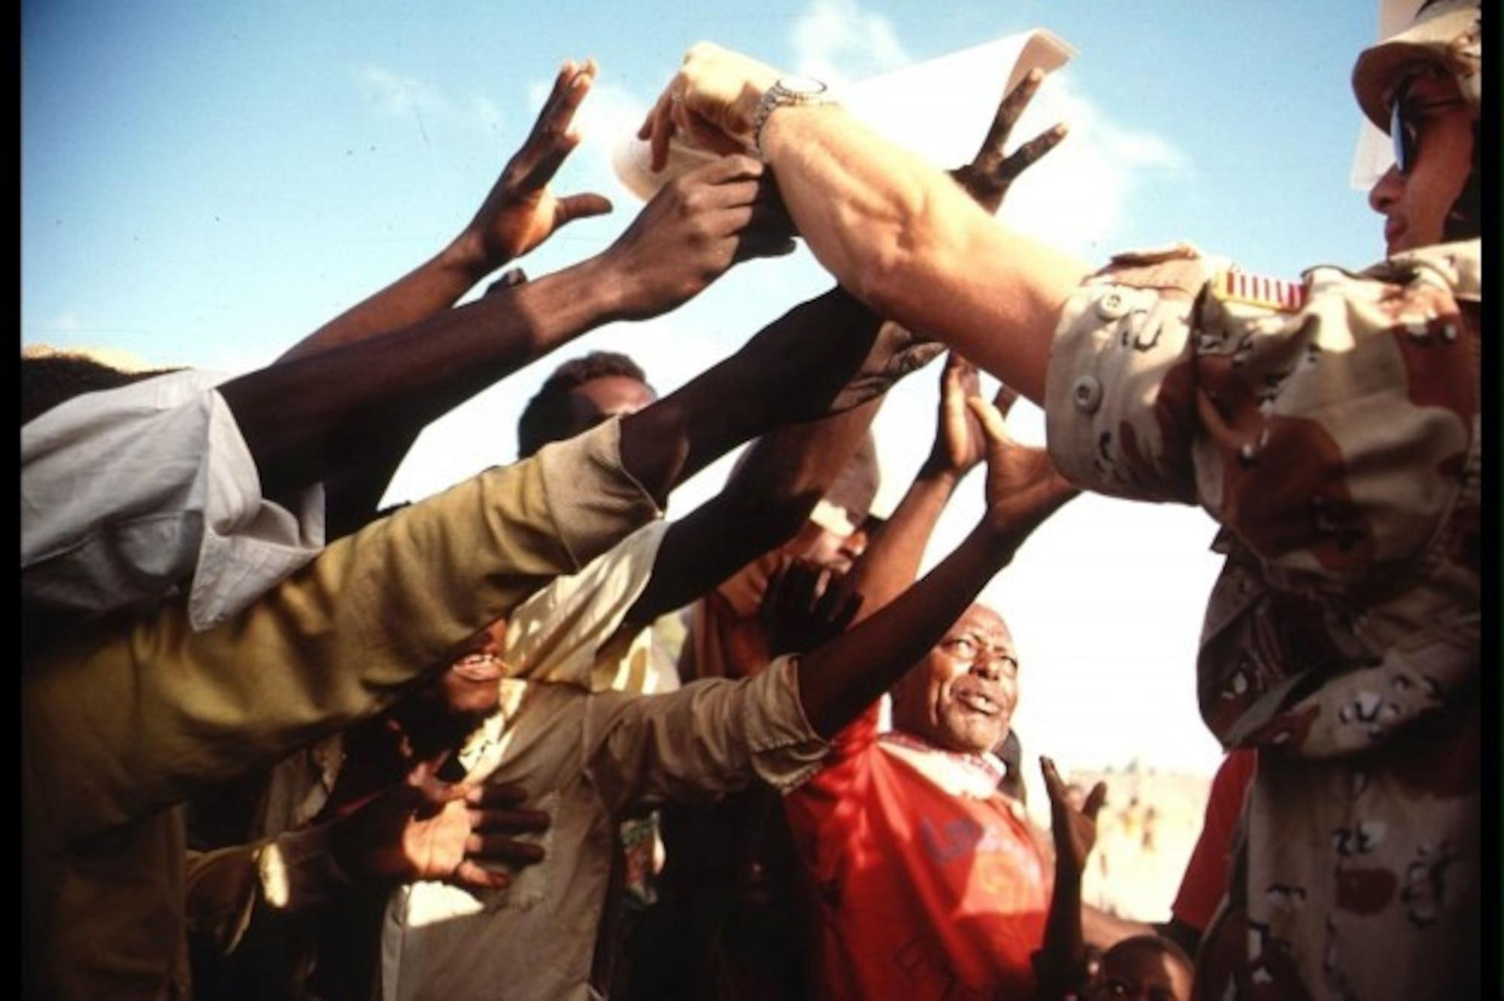
War
Before the war broke out in 1991, Somalia was a beautiful, proud, and rapidly developing nation known as "The Pearl of the Indian Ocean Beautiful Capital Mogadishu was a stunning seaside city filled with white Italian-colonial architecture, historic mosques, and lush palm trees. It was a major destination for tourists, offering vibrant nightlife, jazz clubs, and pristine, peaceful beaches Free Education: The government made education free and mandatory. In the 1970s, Somalia launched a massive literacy campaign that taught millions of rural people how to read and write, achieving one of the highest literacy rates in Africa at the time. What's happening now
How did it began The war in Somalia began because a brutal dictator weaponized the country’s clan system to maintain power, causing the entire government to collapse into chaos when he was overthrown.

Slide 4
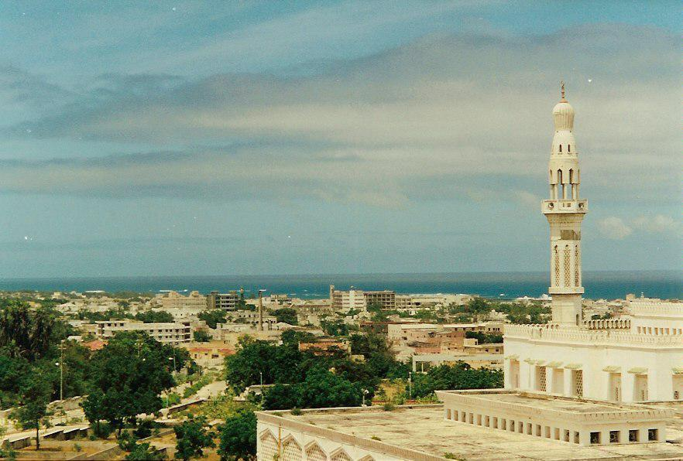
What's going on
1 Political Chaos and Street Fighting in Mogadishu
Violent clashes recently erupted in the capital, Mogadishu, between federal government forces and opposition-allied militias. The fighting broke out over a controversial dispute regarding President Hassan Sheikh Mohamud decision to remain in office past his expired mandate, alongside proposed changes to transition the country away from its traditional clan-based system toward a "one person, one vote" electoral model.

Slide 5
1 https://www.bbc.com/news/topics/cnx753jejqwt
2 https://www.hrw.org/world-report/2026/country-chapters/somalia
3https://igad.int/igad-calls-for-restraint-and-respect-for-somalias-sovereignty-amid-emerging-developments/
4 https://www.crisisgroup.org/africa/horn-africa/somalia

